Slide 1
Raise Responders Major. When, Why and How.

Slide 2
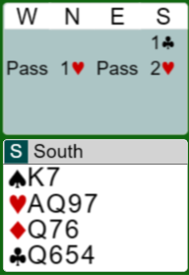
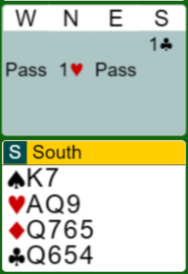
Almost every time you play bridge you are facing the situation where you open 1C/D/H and your partner bids 1M.
With 4-card support you just raise to the proper level. Or use an artificial raise, like
splinter
?
With 3-c support, it´s not that easy.
Your options are 1NT or 2H

Slide 3
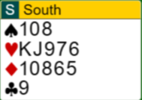
4 card support
Before we address that, we need to agree on how many points you need to bid 1M over your P:s opening. I recommend 4+ points and a 5-card suit
When P opens 1C, bid 1H

Slide 4
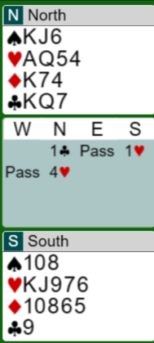
When we have agreed to bid 1M with as little
as 4p, we need to be able to stop before we
get to high.Today many bid 4H with 18-19 bal
and 4-c support.
I don`t recommend that
I certainly don´t want to be in game with
these hands

Slide 5
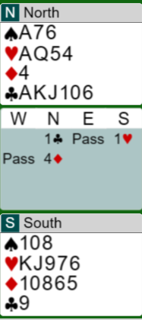
North still has 18 points,
but the game is easy made
Just give South the Queen of Clubs and the slam is laydown. ( if H doesn´t break 4-0)
North can afford a 4D splinter bid

Slide 6
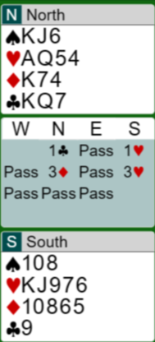
What to do with 4-c support and 18-19 bal?
I suggest you use an artificial raise like 1C-1H; 3D.
The rule is 3M-1, the suit below 3M.
This will not work after 1D-1H,
then you just bid 3H with 18-19 bal
If Responder is strong he can make a cuebid over 3D, if he is slammish
opposit 18-19 bal

Slide 7
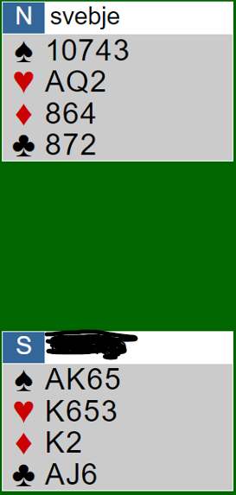
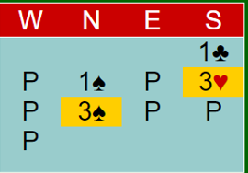
North would surely like to stop in 3♠

Slide 8
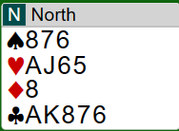
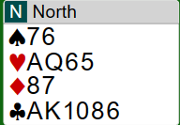
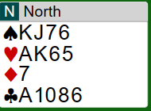
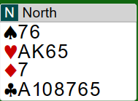
When do you jump to 3H after RP:s 1H?
These hands doesn´t have many points, but have good playing strength.They are well worth a jump raise. Especially since you treat 18-19 differently

Slide 9
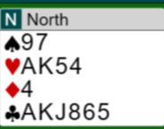
When do you jump to 4H after Reponders 1H?
I think this is a typical hand.
should be 6-4 and good playing
strength.
It should be stronger if you splinter
in D

Slide 10
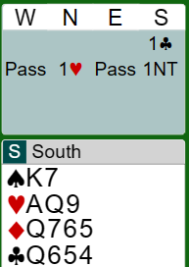
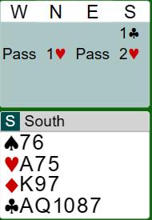
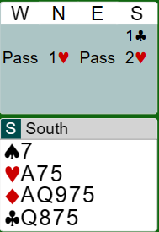
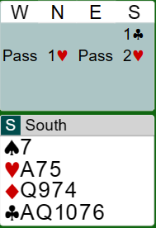
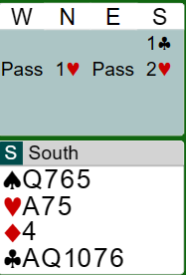
When do you raise with 3-c support?
When you have an unbalanced hand!
Don´t raise with a bal hand with scattered values without a 5-c suit.
1NT
2H
2H
2H
2H

Slide 11
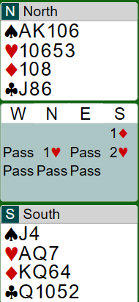
South has a NT oriented hand, so he should bid 1NT

Slide 12
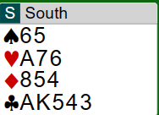
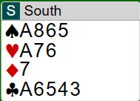
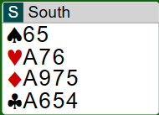
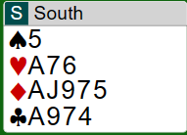
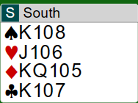
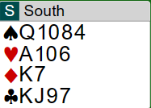
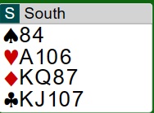
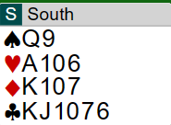
Suit oriented hands
NT oriented hands

Slide 13
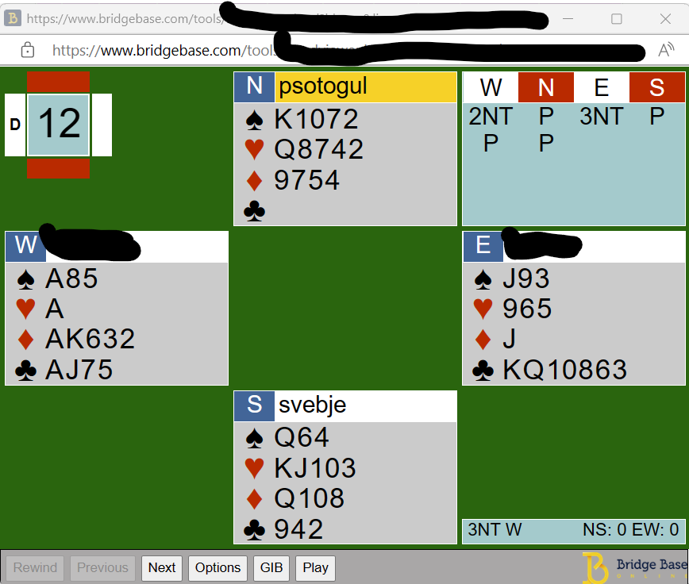
West has a typical suit oriented hand. 7♣ is on without a ♠ lead

Slide 14
PRO:s on raising with 3-c support
Partner may have 5. Trump suit found!
Partner may not dare to rebid his Major with only 5-card
You have an unbalanced suit oriented hand, perhaps a weak doubleton where where a 4-3 part score is better than 1 NT

Slide 15
Cons on raising with only 3-c support
Partner has a weak 4-c suit and 1NT would be a much better contract
You can´t make a 2NT invite which you could do if OP rebid 1NT
If you raise without a 5-c suit you have no place to go
if he inquires with 2NT, You will end up in 3NT which could be to high

Slide 16
When your P raises your M that could be on a 3-c suit you need to inquire if he has 4-c supp.
BUT!! You can only do that if you have close to game strength 11+p.
If OP is allowed to raise without a 5-c suit you must be prepared to play in 3NT.
Otherwise its best to stay in 2H!

Slide 17
If responder bids 3 in your opened minor
it´s invitational values with only 4-c M and 4+ support in OP:s suit.
Otherwise you need to pass 2H. You don´t ”rescue” from the 2-level to the 3-level
If you accept the rule that you don´t raise with 3-c
support unless you have 5-c in your opened minor,
you are well placed.

Slide 18
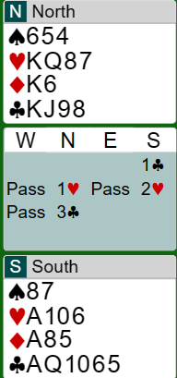
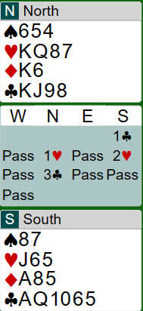
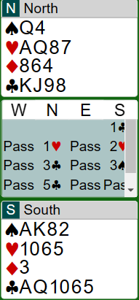
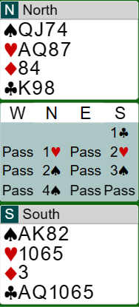
2S is Nat with 4S, inv+, south could have bid 4D
South showed his shape with extras
South should bid on, e.g. 3D
3C is safe

Slide 19
The 2NT inquiry bid.
After 1C-1H;2H-2NT is inquiry,
but 1C-1H;2H-2S is Nat
With 4-c support OP bids 3H with min or 4H with max.
He may also make a spl jump with 4-c supp.
If he only has 3-c support, he rebids a 5-c opening suit or
3 in a lower 4-c suit.
With neither he bids 3 NT

Slide 20
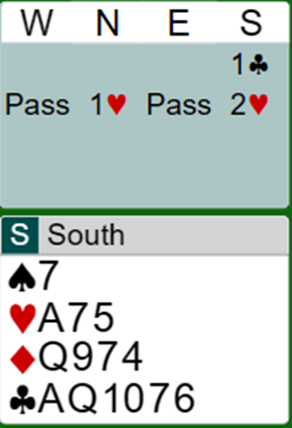
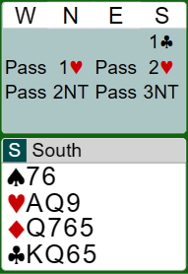
Responses if P bids 2NT
3C to show
1-3-5-4
3C to show 5C
3C to show 5
3C to show 5
You must bid 3NT

Slide 21
When responder has 5-c M
Now he knows you have a trump fit, so he can invite
by raising to 3M, bid a side suit,
inquire or make spl jumps with
slam interest

Slide 22
The X-Y NT over 1NT
After 1m-1M;1NT :
2C=relay to 2D, then pass or 2M as invite, 2NT relay to 3C
2D=GF, then Nat up the line
2M= sign off
2OM=NF, 5-4 in M
2NT=bal invite

Slide 23
After 1m-1M;2NT ( 18-19 )
3C=relay to 3D, then pass or 3M as invite, 3NT = slam try in opened minor
3D=GF relay, then Nat up the line
3M=sign off
3OM=invite 5-4 in M

Slide 24
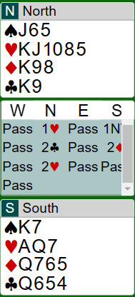
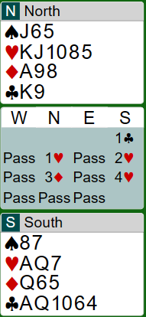
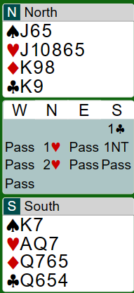
Use X-Y to invite with 5H
Invite with 3H or 3D
Sign off

Slide 25
Isn´t it dangerous to rebid a 5-c Major over OP:s 1NT?
Normally not. If your P opened 1NT you would always transfer to a 5-c Major.
The only risk is if OP rebid 1NT with a singelton in your Major.
That´s why I recommend you to never rebid NT with a spl in P:s suit.
This is also applicable if it goes 1H-2D; do not bid 2NT with a spl in diamonds.
Try to find another bid. P will expect you have at least xx in D.

Slide 26
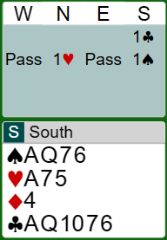
If you have a strong hand and 3-c support?
You can´t make a simple raise, you have to find
another bid and hope to get back to show support.
Bid 1S, if your P bids something you can show H support,perhaps with a jump. Then your shape and strenght will be clear.
If your P passes 1S you have stayed at a safe level ☺

